Slide 1
11. Multiple Regression
y – response variable
x₁, x₂ , … , x_{k} -- a set of explanatory variables
In this chapter, all variables assumed to be quantitative. Chapters 12-14 show how to incorporate categorical variables also in a regression model.
Multiple regression equation (population):
E(y) = α + β₁x₁ + β₂x₂ + …. + β_{k}x_{k}

Slide 2
Parameter Interpretation
α = E(y) when x₁ = x₂ = … = x_{k} = 0.
β₁, β₂ , … , β_{k} are called partial regression coefficients.
Controlling for other predictors in model, there is a linear relationship between E(y) and x₁ with slope β_{1.}
i.e., if x₁ goes up 1 unit with other x’s held constant, the change in E(y) is
[α + β₁(x₁ + 1) + β₂x₂ + …. + β_{k}x_{k}] – [α + β₁x₁ + β₂x₂ + …. + β_{k}x_{k}]
= β_{1.}

Slide 3
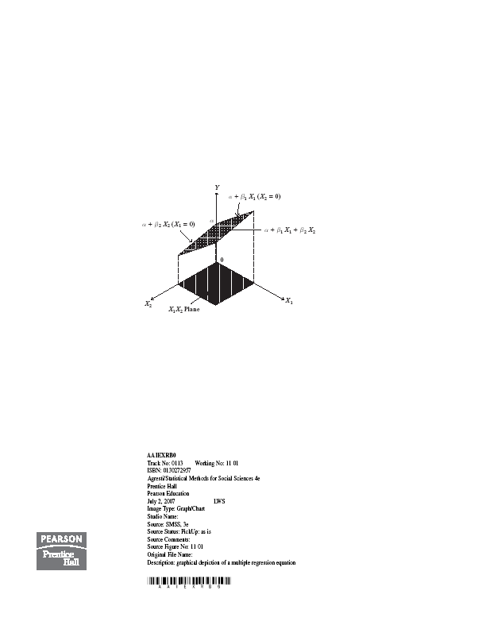

Slide 4
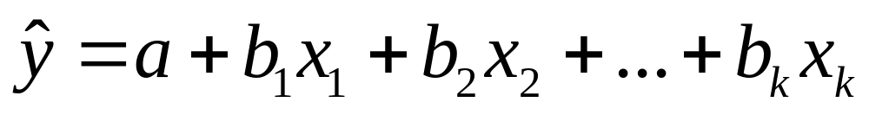
Prediction equation
With sample data, we get “least squares” estimates of parameters by minimizing
SSE = sum of squared prediction errors (residuals)
= (observed y – predicted y)²
to get a sample prediction equation

Slide 5
Example: Mental impairment study
y = mental impairment (summarizes extent of psychiatric symptoms, including aspects of anxiety and depression, based on questions in “Health opinion survey” with possible responses hardly ever, sometimes, often)
Ranged from 17 to 41 in sample, mean = 27, s = 5.
x₁ = life events score (composite measure of number and severity of life events in previous 3 years)
Ranges from 0 to 100, sample mean = 44, s = 23
x₂ = socioeconomic status (composite index based on occupation, income, and education)
Ranges from 0 to 100, sample mean = 57, s = 25
Data (n = 40) at www.stat.ufl.edu/~aa/social/data.html and p. 327 of text

Slide 6
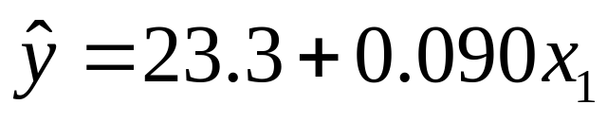
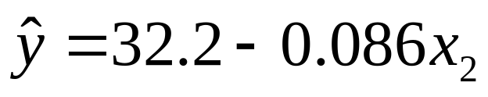
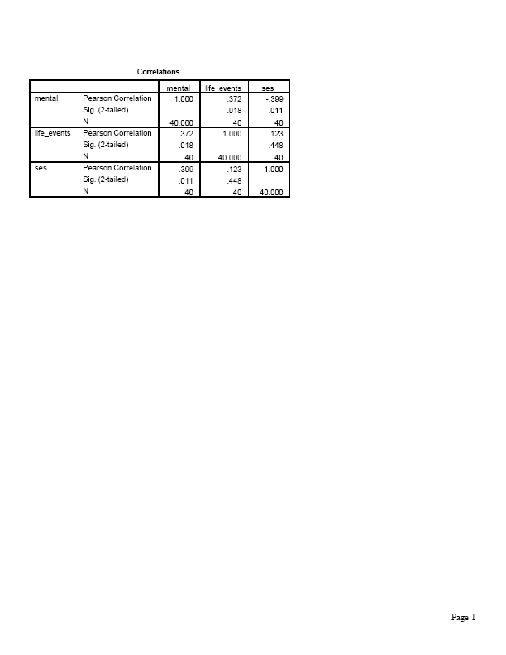
Other explanatory variables in study (not used here) include age, marital status, gender, race
Bivariate regression analyses give prediction equations:
Correlation matrix

Slide 7
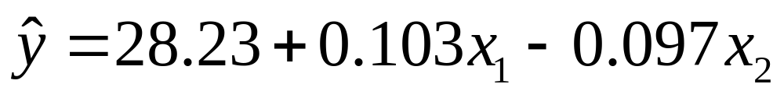
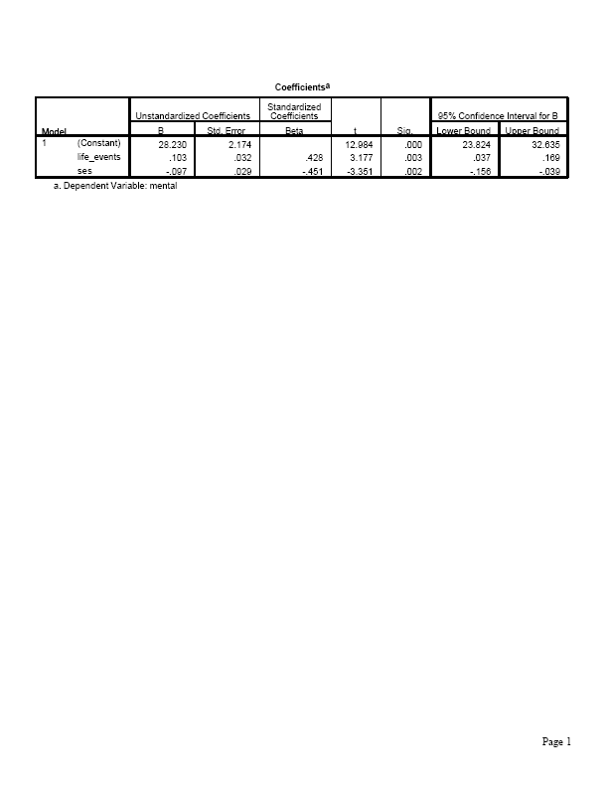
Prediction equation for multiple regression analysis is:

Slide 8
Predicted mental impairment:
increases by 0.103 for each 1-unit increase in life events, controlling for SES.
decreases by 0.097 for each 1-unit increase in SES, controlling for life events.
(e.g., decreases by 9.7 when SES goes from minimum of 0 to maximum of 100, which is relatively large since sample standard deviation of y is 5.5)

Slide 9
Can we compare the estimated partial regression coefficients to determine which explanatory variable is “most important” in the predictions?
These estimates are unstandardized and so depend on units.
“Standardized coefficients” presented in multiple regression output refer to partial effect of a standard deviation increase in a predictor, keeping other predictors constant. (Sec. 11.8).
In bivariate regression, standardized coefficient = correlation. In multiple regression, std. coeff. relates algebraically to “partial correlations” (Sec. 11.7).
We skip or only briefly cover Sec. 11.7, 11.8 (lack of time), but I’ve included notes at end of this chapter on these topics.

Slide 10
Predicted values and residuals
One subject in the data file (p. 327) has
y = 33, x₁ = 45 (near mean), x₂ = 55 (near mean)
This subject has predicted mental impairment
(near mean)
The prediction error (residual) is 33 – 27.5 = 5.5
i.e., this person has mental impairment 5.5 higher than predicted given his/her values of life events, SES.
SSE = 768.2 smaller than SSE for either bivariate model or for any other linear equation with predictors x_{1 ,} x₂.

Slide 11
Comments
Partial effects in multiple regression refer to controlling other variables in model, so differ from effects in bivariate models, which ignore all other variables.
Partial effect of x₁ (controlling for x₂) is same as bivariate effect of x₁ when correlation = 0 between x₁ and x₂
(as is true in most designed experiments).
Partial effect of a predictor in this multiple regression model is identical at all fixed values of other predictors in model
Example:
At x₂ = 0,
At x₂ = 100,

Slide 12
This parallelism means that this model assumes no interaction between predictors in their effects on y. (i.e., effect of x₁ does not depend on value of x₂)
Model is inadequate if, in reality
(insert graph)
The model E(y) = α + β₁x₁ + β₂x₂ + …. + β_{k}x_{k}
is equivalently expressed as
y = α + β₁x₁ + β₂x₂ + …. + β_{k}x_{k} + 
where  = y – E(y) = “error” having E() = 0 is population analog of residual e = y – predicted y.

Slide 13
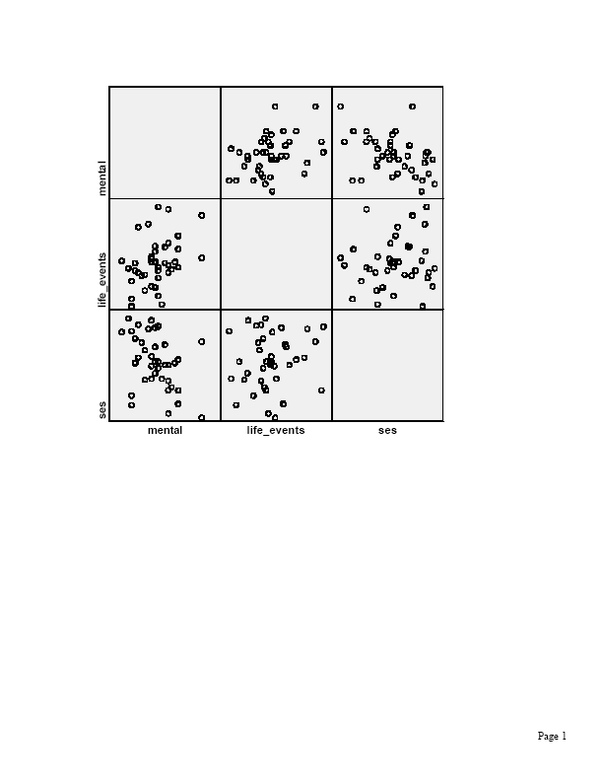
Graphics for multiple regression
Scatterplot matrix: Scatterplot for each pair of variables

Slide 14
Partial regression plots: One plot for each predictor, shows its partial effect controlling for other predictors
Example: With two predictors, show partial effect of x₁ on y (i.e., controlling for x₂) by using residuals after
Regressing y on x₂
Regressing x₁ on x₂
Partial regression plot is a scatterplot with residuals from regressing y on x₂ on vertical axis and residuals from regressing x₁ on x₂ on horizontal axis.
The prediction equation for these points has the same slope as the effect of x₁ in the prediction equation for the multiple regression model.

Slide 15
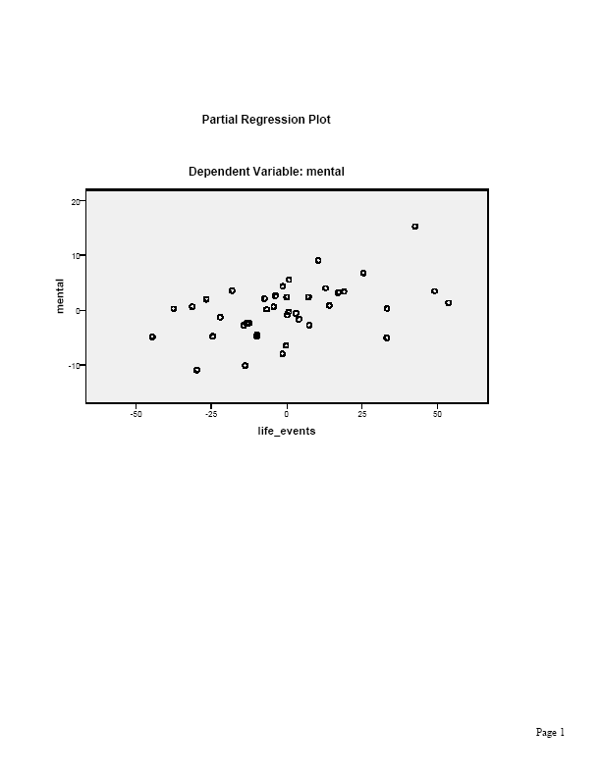

Slide 16
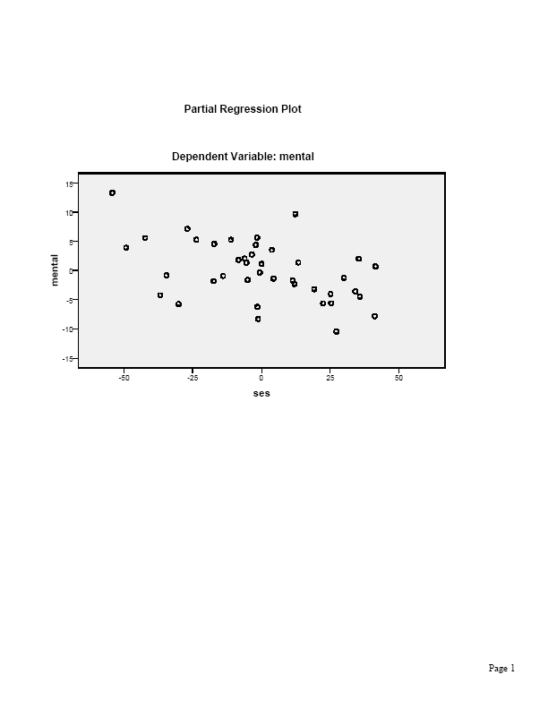

Slide 17
Multiple correlation and R²
How well do the explanatory variables in the model predict y, using the prediction equation?
The multiple correlation, denoted by R, is the correlation between the observed y-values and predicted values
from the prediction equation.
i.e., it is the ordinary correlation between y and an artificial variable whose values for the n subjects in the sample are the predicted values from the prediction equation.

Slide 18
Example: Mental impairment predicted by life events and SES
The multiple correlation is the correlation between the
n = 40 pairs of values of observed y and predicted y values:
Subject y Predicted y
1 17 24.8 = 28.23 + 0.103(46) – 0.097(84)
2 19 22.8 = 28.23 + 0.103(39) – 0.097(97)
3 20 28.7 = 28.23 + 0.103(27) – 0.097(24)
……
Software reports R = 0.58
(bivariate correlations with y were 0.37 for x₁, -0.40 for x₂)

Slide 19

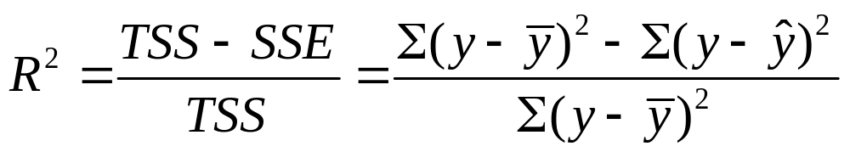
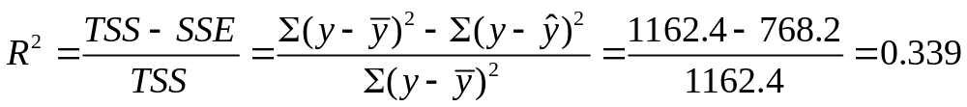
The coefficient of multiple determination R² is the proportional reduction in error obtained by using the prediction equation to predict y instead of using to predict y
Example: Predictor TSS SSE R²
x₁ 1162.4 1001.4 0.14
x₂ 1162.4 977.7 0.16
x_{1 ,} x₂ 1162.4 768.2 0.34
For the multiple regression model,

Slide 20
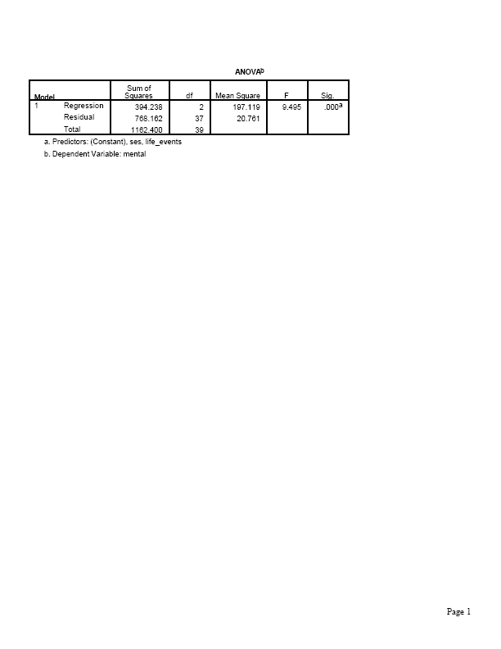
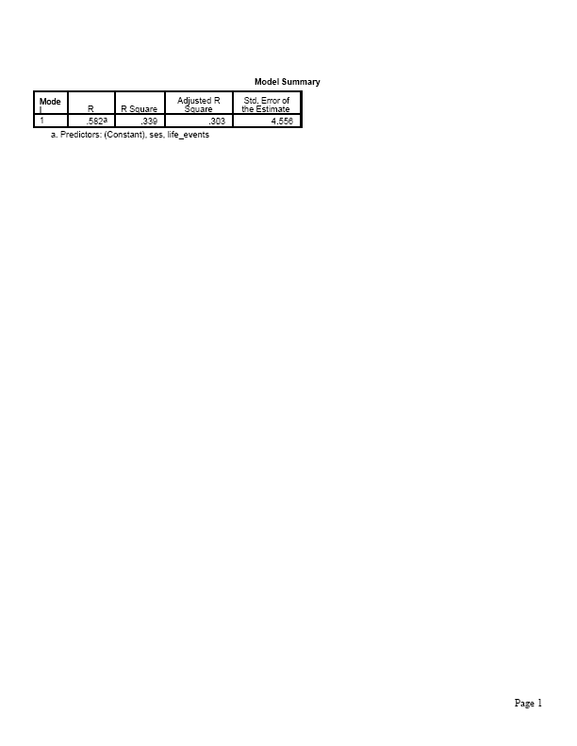
Software provides an ANOVA table with the sums of squares used in R-squared and a Model Summary table with values of R and R-squared.

Slide 21
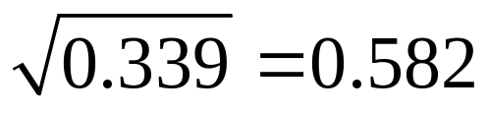
There is a 34% reduction in error when we use life events and SES together to predict mental impairment (via the prediction equation), compared to using to predict mental impairment.
This is sometimes expressed as “34% of the variation in mental impairment is explained by life events and SES.”
The multiple correlation is R =
= the correlation between the 40 values of y and the 40 corresponding predicted y-values from the prediction equation for the multiple regression model.

Slide 22
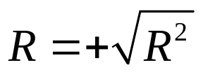
Properties of R and R²
0 ≤ R² ≤ 1
so 0 ≤ R ≤ 1 (i.e., it can’t be negative)
The larger their values, the better the set of explanatory variables predict y
R² = 1 when observed y = predicted y, so SSE = 0
R² = 0 when all predicted y = so TSS = SSE.
When this happens, b₁ = b₂ = … = b_{k} = 0 and the correlation r = 0 between y and each predictor.
R² cannot decrease when predictors added to model
With single predictor, R² = r² , R = |r|

Slide 23
The numerator of R², which is TSS – SSE, is called the regression sum of squares. This represents the variability in y “explained” by the model.
R² is additive (i.e., it equals the sum of r² values from bivariate regressions of y with each x) when each pair of explanatory variables is uncorrelated; this is true in many designed experiments, but we don’t expect it in observational studies.
Sample R² tends to be a biased estimate (upwards) of population value of R² , more so for small n (e.g., extreme case -- consider n = 2 in bivariate regression!) Software also reports adjusted R², a less biased estimate (p. 366, Exer. 11.61)
In observational studies with many predictors, explanatory var’s are often sufficiently correlated that we can predict one of them well using the others – called multicollinearity – consider later.
(picture)

Slide 24
Inference for multiple regression
Based on assumptions
Model E(y) = α + β₁x₁ + β₂x₂ + …. + β_{k}x_{k} is (nearly) correct
Population conditional distribution of y is normal, at each combination of predictor values
Standard deviation σ of conditional dist. of responses on y is same at each combination of predictor values
(The estimate s of σ is the square root of MSE. It is what SPSS calls “Std. error of the estimate” in the Model Summary table!)
Sample is randomly selected
Two-sided inference about β parameters is robust to normality and common σ assumptions

Slide 25
Collective influence of explanatory var’s
To test whether explanatory variables collectively have effect on y, we test
H₀ : ₁ = ₂ = … = _{k} = 0
(i.e., y independent of all the explanatory variables)
H_{a}: At least one _{i} ≠ 0
(at least one explanatory variable has an effect on y, controlling for the others in the model)
Equivalent to testing
H₀: population multiple correlation = 0 (or popul. R² = 0)
vs. H_{a}: population multiple correlation > 0

Slide 26
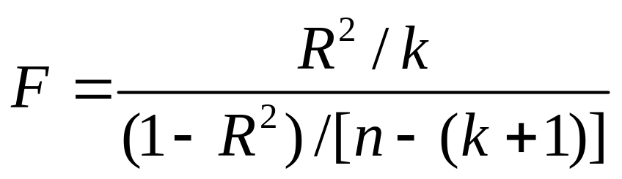
Test statistic (with k explanatory variables)
When H₀ true, F values follow the F distribution
(R. A. Fisher)
For given n, larger R gives larger F test statistic, more evidence against null hypothesis.
Since larger F gives stronger evidence against null, P-value = right-tail probability above observed value

Slide 27
Properties of F distribution
F can take only nonnegative values
Distribution is skewed right
Exact shape depends on two df values:
df₁ = k (number of explanatory variables in model)
df₂ = n – (k + 1) (sample size – no. model
parameters)
Mean is approximately 1 (closer to 1 for large n)
F tables report F-scores for right-tail probabilities such as 0.05, 0.01, 0.001 (one table for each tail prob.)

Slide 28
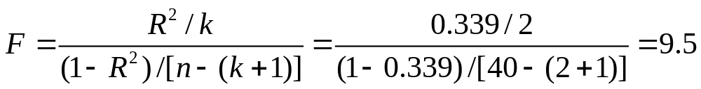
Example: Is mental impairment independent of life events and SES?
H₀ : ₁ = ₂ = 0
(i.e., y independent of x₁ and x₂)
H_{a}: ₁ ≠ 0 or ₂ ≠ 0 or both
Test statistic
df₁ = 2, df₂ = 37, P-value = 0.000 (i.e., P < 0.001)
(From F table, F = 8.4 has P-value = 0.001)

Slide 29
Software provides ANOVA table with result of F test about all regression parameters

Slide 30
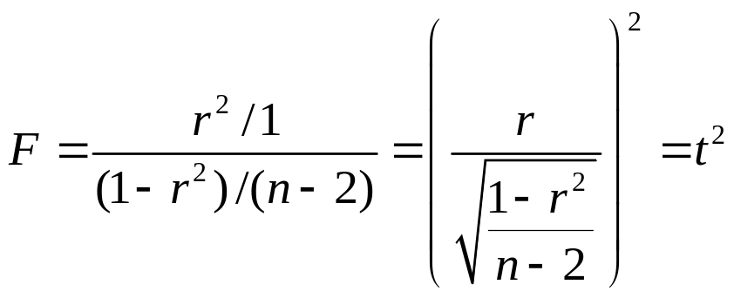
There is very strong evidence that at least one of the explanatory variables is associated with mental impairment.
Alternatively, can calculate F as ratio of mean squares from the ANOVA table.
Example: F = 197.12/20.76 = 9.5
When only k=1 predictor,
the square of the t stat. = b/(se) for testing H₀:  = 0.
(If t is a statistic having a t distribution, then t² has the F dist with df₁ = 1, df₂ = df for the t statistic.)

Slide 31
Inferences for individual regression coefficients (Need all predictors in model?)
To test partial effect of x_{i} controlling for the other explan. var’s in model, test H₀: _{i} = 0 using test stat.
t = (b_{i} – 0)/se, df = n - (k + 1)
which is df₂ from the F test (and in df column of ANOVA table in Residual row)
CI for _{i} has form b_{i} ± t(se), with t-score from t-table also having
df = n - (k + 1), for the desired confidence level
Software provides estimates, standard errors, t test statistics, P-values for tests (2-sided by default)

Slide 32
In SPSS, check “confidence intervals” under “Statistics” in Linear regression dialog box to get CI’s for regression parameters (95% by default)

Slide 33
Example: Effect of SES on mental impairment, controlling for life events
H₀: ₂ = 0, H_{a}: ₂ ≠ 0
Test statistic t = b₂/se = -0.097/0.029 = -3.35,
df = n - (k + 1) = 40 – 3 = 37.
Software reports P-value = 0.002
Conclude there is very strong evidence that SES has a negative effect on mental impairment, controlling for life events. (We would reject H₀ at standard significance levels, such as 0.05.)
Likewise for test of H₀: ₁ = 0 (P-value = 0.003), but life events has positive effect on mental impairment, controlling for SES.

Slide 34
A 95% CI for ₂ is b₂ ± t(se), which is
-0.097 ± 2.03(0.029), or (-0.16, -0.04)
This does not contain 0, in agreement with rejecting H₀ for two-sided H_{a} at 0.05 significance level
Perhaps simpler to interpret corresponding CI of
(-16, -4) for the change in mean mental impairment for an increase of 100 units in SES (from minimum of 0 to maximum of 100).
(relatively wide CI because of relatively small n = 40)
Why bother with F test? Why not go right to the t tests?

Slide 35
A caution: “Overlapping variables” (multicollinearity)
It is possible to get a small P-value in F test of
H₀ : ₁ = ₂ = … = _{k} = 0 yet not get a small P-value for any of the t tests of individual H₀: _{i} = 0
Likewise, it is possible to get a small P-value in a bivariate test for a predictor but not for its partial test controlling for other variables.
This happens when the partial variability explained uniquely by a predictor is small. (i.e., each x_{i} can be predicted well using the other predictors) (picture)
Example (purposely absurd): y = height
x₁ = length of right leg, x₂ = length of left leg

Slide 36
When multicollinearity occurs,
se values for individual b_{i} may be large
(and individual t statistics not significant)
R² may be nearly as large when drop some predictors from model
It is advisable to simplify the model by dropping some “nearly redundant” explanatory variables.

Slide 37
Modeling interaction between predictors
Recall that the multiple regression model
E(y) = α + β₁x₁ + β₂x₂ + …. + β_{k}x_{k}
assumes the partial slope relating y to each x_{i} is the same at all values of other predictors (i.e., assumes “no interaction” between pairs of predictors)
(recall picture showing parallelism)
For a model allowing interaction between x₁ and x₂ the effect of x₁ may change as x₂ changes.

Slide 38

Simplest interaction model: Introduce cross product terms for predictors
Ex: k = 2 explan var’s: E(y) = α + β₁x₁ + β₂x₂ + β₃(x₁x₂)
is special case of the multiple regression model
E(y) = α + β₁x₁ + β₂x₂ + β₃x₃
with x₃ = x₁x₂ (create x₃ in “transform” menu with “compute variable” option in SPSS)
Example: For mental impairment data, we get
= 26.0 + 0.156x₁ - 0.060x₂ - 0.00087x₁x₂

Slide 39

SPSS output for interaction model
(need more decimal places! Highlight table and repeatedly click on the value.)

Slide 40
Fixed x₂ Prediction equation for y and x₁
0 26.0 + 0.156x₁ - 0.060(0) - 0.00087 x₁(0)
= 26.0 + 0.16x₁
50 26.0 + 0.156x₁ - 0.060(50) - 0.00087 x₁(50)
= 23.0 + 0.11x₁
100 26.0 + 0.156x₁ - 0.060(100) - 0.00087 x₁(100)
= 20.0 + 0.07x₁
The higher the value of SES, the weaker the relationship between y = mental impairment and x₁ = life events (plausible for these variables)
(picture)

Slide 41
Comments about interaction model
Note that E(y) = α + β₁x₁ + β₂x₂ + β₃x₁x₂
= (α + β₂x₂) + (β₁ + β₃x₂)x₁
i.e, E(y) is a linear function of x₁
E(y) = (constant with respect to x₁ ) + (coeff. of x₁)x₁
where coefficient of x₁ is (β₁ + β₃x₂).
For fixed x₂ the slope of the relationship between E(y) and x₁ depends on the value of x_{2 .}
To model interaction with k > 2 explanatory variables, take cross product for each pair; e.g., k = 3:
E(y) = α + β₁x₁ + β₂x₂ + β₃x₃ + β₄x₁x₂ + β₅x₁x₃ + β₆x₂x₃

Slide 42
To test H₀: no interaction in model E(y) = α + β₁x₁ + β₂x₂ + β₃x₁x₂, test H₀: β₃ = 0 using test statistic
t = b₃ /se.
Example: t = -0.00087/0.0013 = -0.67, df = n – 4 = 36.
P-value = 0.51 for H_{a} : β₃ ≠ 0
Insufficient evidence to conclude that interaction exists.
(It is significant for the entire data set, with n > 1000)
With several predictors, often some interaction terms are needed but not others. E.g., could end up using model such as E(y) = α + β₁x₁ + β₂x₂ + β₃x₃ + β₄x₁x₂
Be careful not to misintepret “main effect” terms when there is interaction between them in the model.

Slide 43
Comparing two regression models
How to test whether a model gives a better fit than a simpler model containing only a subset of the predictors?
Example: Compare
E(y) = α + β₁x₁ + β₂x₂ + β₃x₃ + β₄x₁x₂ + β₅x₁x₃ + β₆x₂x₃
to
E(y) = α + β₁x₁ + β₂x₂ + β₃x₃
to test H₀: no interaction by testing H₀: β₄ = β₅ = β₆ = 0.

Slide 44
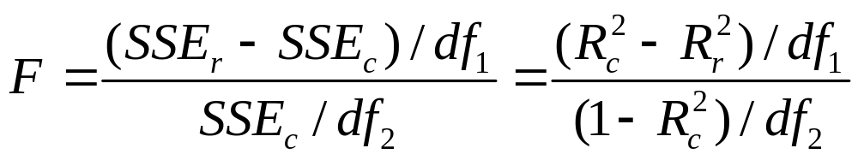
An F test compares the models by comparing their SSE values, or equivalently, their R² values.
The more complex (“complete”) model is better if its SSE is sufficiently smaller (or equivalently if its R² value is sufficiently larger) than the SSE (or R²) value for the simpler (“reduced”) model.
Denote the SSE values for the complete and reduced models by SSE_{c} and SSE_{r.} Denote the R² values by R²_{c} and R²_{r.}
The test statistic for comparing the models is
df₁ = number of extra parameters in complete model,
df₂ = n-(k+1) = df₂ for F test that all β terms in complete model = 0
(e.g., df₂ = n – 7 for model above)

Slide 45
Example: Mental impairment study (n = 40)
Reduced model: E(y) = α + β₁x₁ + β₂x₂
for x₁ = life events score, x₂ = SES
Complete model: E(y) = α + β₁x₁ + β₂x₂ + β₃x₃
with x₃ = religious attendance (number of times subject attended religious service in past year)
R²_{r} = 0.339, R²_{c} = 0.358
Test comparing models has H₀: β₃ = 0.

Slide 46
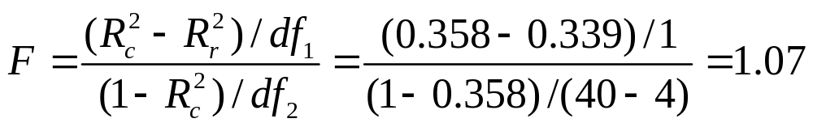
Test statistic with df₁ = 1, df₂ = 36.
P-value = 0.31.
We cannot reject H₀ at the usual significance levels (such as 0.05). The simpler model is adequate.
Note: Since only one parameter in null hypo., the F test statistic is the square of t = b₃/se for testing H₀: β₃ = 0. The t test also gives P-value = 0.31, for H_{a}: β₃ ≠ 0

Slide 47
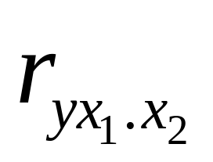
Partial Correlation
Used to describe association between y and an explanatory variable, while controlling for the other explanatory variables in the model
Notation:
denotes the partial correlation between y and x₁ while controlling for x_{2.}
Formula in text (p. 347), which we’ll skip, focusing on interpretation and letting software do the calculation. (“correlate” on “Analyze” menu has a “partial correlation” option)

Slide 48
Properties of partial correlation
Falls between -1 and +1.
The larger the absolute value, the stronger the association, controlling for the other variables
Does not depend on units of measurement
Has same sign as corresponding partial slope in the prediction equation
Can regard as approximating the ordinary correlation between y and x₁ at a fixed value of x₂.
Equals ordinary correlation found for data points in the corresponding partial regression plot
Squared partial correlation has a proportional reduction in error (PRE) interpretation for predicting y using that predictor, controlling for other explan. var’s in model.

Slide 49
Example: Mental impairment as function of life events and SES
The ordinary correlations are:
0.372 between y and life events
-0.399 between y and SES
The partial correlations are:
0.463 between y and life events, controlling for SES
-0.483 between y and SES, controlling for life events

Slide 50
Notes:
Since partial correlation = 0.463 between y and life events, controlling for SES,
and since (0.463)² = 0.21,
“Controlling for SES, 21% of the variation in mental impairment is explained by life events.”
or
“Of the variability in mental impairment unexplained by SES, 21% is explained by life events.”

Slide 51
Test of H₀ : population partial correlation = 0
is equivalent to t test of
H₀ : population partial slope = 0
For the corresponding regression parameter.
e.g., model E(y) = α + β₁x₁ + β₂x₂ + β₃x₃
H₀ : population partial correlation = 0 between y and x₂ controlling for x₁ and x₃
is equivalent to test of
H₀ : β₂ = 0

Slide 52
Standardized Regression Coefficients
Recall for a bivariate model, the correlation is a “standardized slope,” reflecting what the slope would be if x and y had equal standard dev’s.
In multiple regression, there are also standardized regression coefficients that describe what the partial regression coefficients would equal if all variables had the same standard deviation.
Def: The standardized regression coefficient for an explanatory variable represents the change in the mean of y (in y std. dev’s) for a 1-std.-dev. increase in that variable, controlling for the other explanatory variables in the model

Slide 53
r = b(s_{x}/s_{y}) (bivariate) generalizes to
b₁* = b₁ (s_{x1} / s_{y} )
b₂* = b₂ (s_{x2} / s_{y} ), etc.
Properties of standardized regression coeff’s:
Same sign as unstandardized coefficients, but do not depend on units of measurement
Represent what the partial slopes would be if the standard deviations were equal
Equals 0 when unstandardized coeff. = 0, so a new test is not needed about significance
SPSS reports in same table as unstandardized coefficients

Slide 54
Example: Mental impairment by life events and SES
We found unstandardized equation
Standard deviations s_{y} = 5.5, s_{x1} = 22.6, s_{x2} = 25.3
The standardized coefficient for the effect of life events is
b₁* = 0.103(22.6/5.5) = 0.43. Likewise b₂* = -0.45

Slide 55
We estimate that E(y) increases by 0.43 standard deviations for a 1 std. dev. increase in life events, controlling for SES.
Note:
An alternative form for prediction equations uses standardized regression coefficients as coefficients of standardized variables
(text, p. 352)

Slide 56
Some multiple regression review questions
Predicted cost = -19.22 + 0.29(food) + 1.58(décor) + 0.90(service)
The correct interpretation of the estimated regression coefficient for décor is: for every 1-point increase in the décor score, the cost of dining increases by $1.58
Décor is the most important predictor
Décor has a positive correlation with cost
Ignoring other predictors, it is impossible that décor could have a negative correlation with cost
The t statistic for testing the partial effect of décor against the alternative of a positive effect could have a P-value above 0.50
None of the above

Slide 57
(T/F) For the multiple regression model with two predictors, if the correlation between x₁ and y is 0.50 and the correlation between x₂ and y is 0.50, it is possible that the multiple correlation R = 0.35.
For the previous exercise in which case would you expect R to be larger: when the correlation between x₁ and x₂ is 0, or when it is 1.0?
(T/F) For every F test, there is always an equivalent t test.
Explain with an example what it means for there to be (a) no interaction, (b) interaction between two quantitative explanatory variables in their effects on a quantitative response variable.
Give an example of interaction when the three variables are categorical (see back in Chap. 10).

Slide 58
Approximately what value do you expect to see for a F test statistic when a null hypothesis is true?
(T/F) If you get a small P-value in the F test that all regression coefficients = 0, then the P-value will be small in at least one of the t tests for the individual regression coefficients.
Why do we need the F (chi-squared) distribution? Why can’t we use the t (normal) distribution for all hypotheses involving quantitative (categorical) var’s?
What is the connection between (a) t and F,
(b) z and chi-squared?

